Slide 1


PrAVI WIZARD LUXURIOUS
HoteL
2023
DBMS MINI PROJECT
HOTEL MANAGEMENT SYSTEM

Slide 2

Hotel management system
Under the Guidance of,
Prof. Sushma KSN
Presentation by,
Santosh Kumar Paital (1HK20CS143)
Sarvesh Raj (1HK20CS146)
Shrey Verma (1HK20CS152)

Slide 3

Software Requirements:
Hardware Requirements:
Front End: Java Swing
Back End: MySQL
Database: SQLITE SERVER 2008 or higher
The following operating systems are officially supported:
Windows 7 (64-bit, Professional level or higher)
Mac OS X 10.5.1+
Ubuntu 9.10 (64bit)
Ubuntu 8.04 (32bit/64bit)
CPU: Intel Core or Xeon 3GHz (or Dual Core 2GHz) or equal AMD CPU.
Cores: Single (Dual/Quad Core is recommended)
RAM: 4 GB (8 GB recommended)
Graphic Accelerators: nVidia or ATI with support of OpenGL 1.5 or higher.
DisplayResolution: 1280×1024 is recommended, 1024×768 is minimum

Slide 4

PROBLEM STATEMENT
There are a lot of challenges faced by hotel managers every day like several operational issues, handling customer’s problems, keeping a record of rooms, clients, and bookings, unorganized housekeepings, securing data from cyber attacks, maintaining reputation over internet, finding loyal and hardworking staff and handling the staff problems, beat the rising competition, maintaining customer relationship, and a lot more.

Slide 5
SOLUTION
The objective of the project is to computerize the system of the hotel. “Hotel Management” is the project not only keeps the record of various people like customers, manager etc. but as well as it reduces the extensive paper work in the present system. It will make the system more versatile and user friendly.
It also calculates the proper billing slip of high level and middle level customers. This project is based on description about the structure of HOTEL MANAGEMENT SYSTEM.

Slide 6

introduction
The project contains:
Keeping the record of all persons like customers, etc.
Maintains proper list of all persons.
The system is useful as it calculates an exact cost of rooms for requested number of days.
It saves organization resources and expenses.
This system is effective and saves time and cost of users.

Slide 7
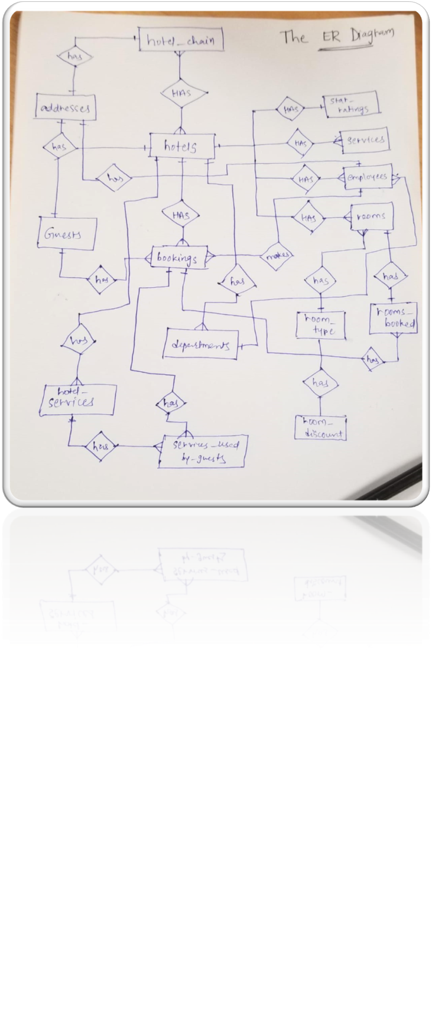
Er diagram
We drew the ERR diagram on a paper, noting down all the tables required

Slide 8
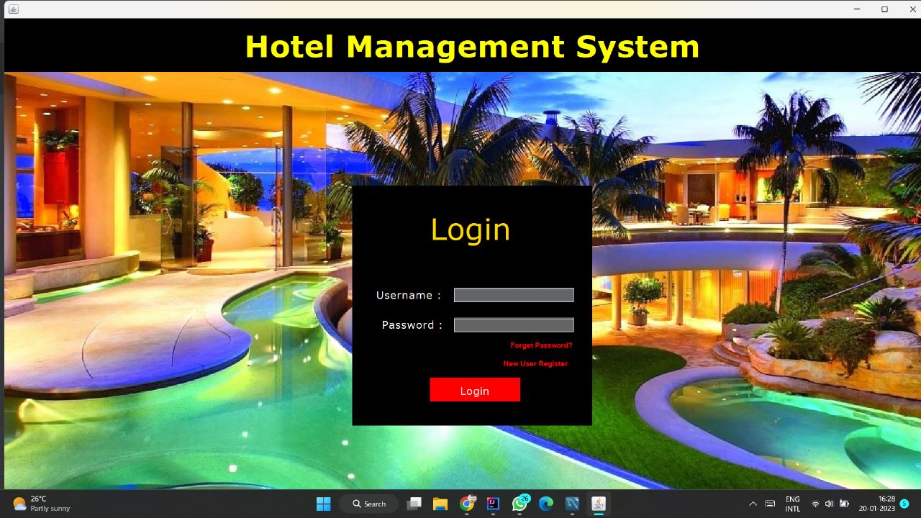
SNAPSHOTS

Slide 9
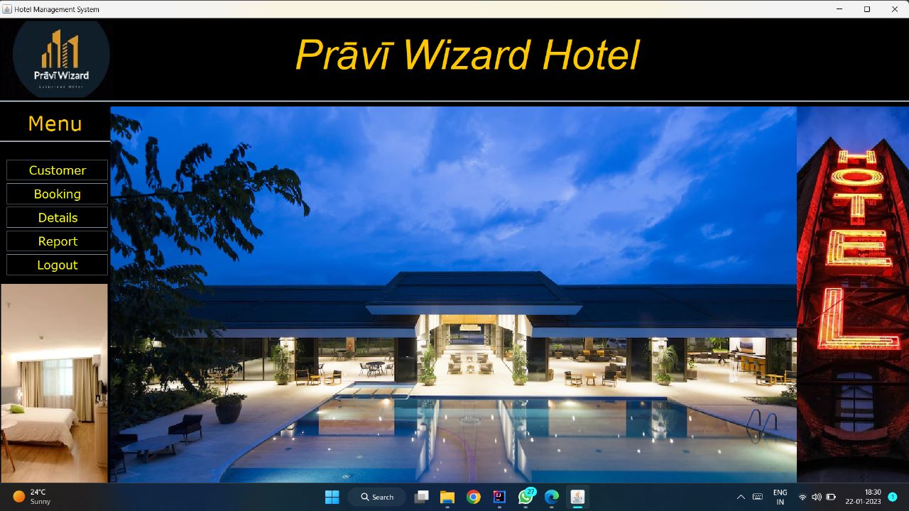
SNAPSHOTS

Slide 10
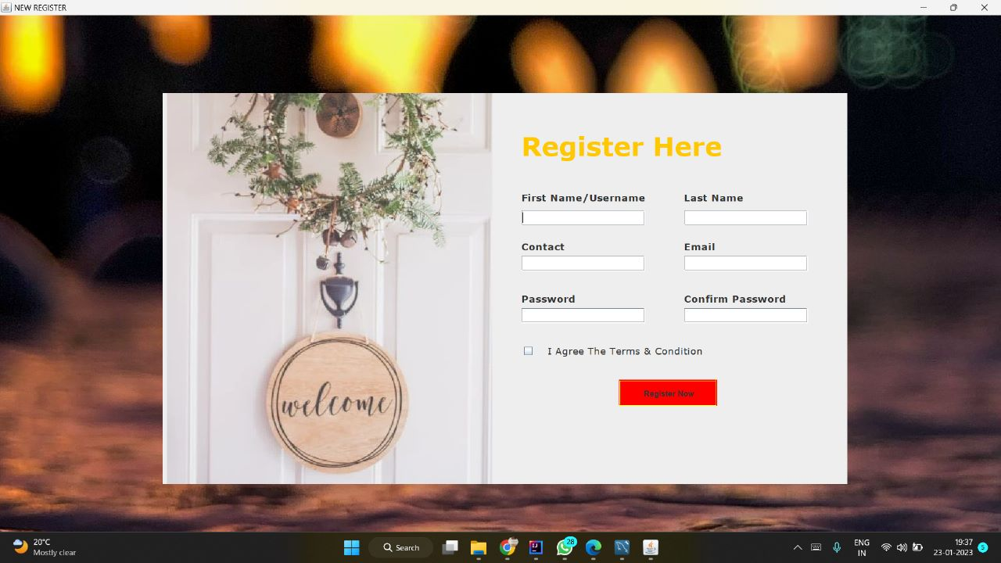
SNAPSHOTS
NEW USER

Slide 11
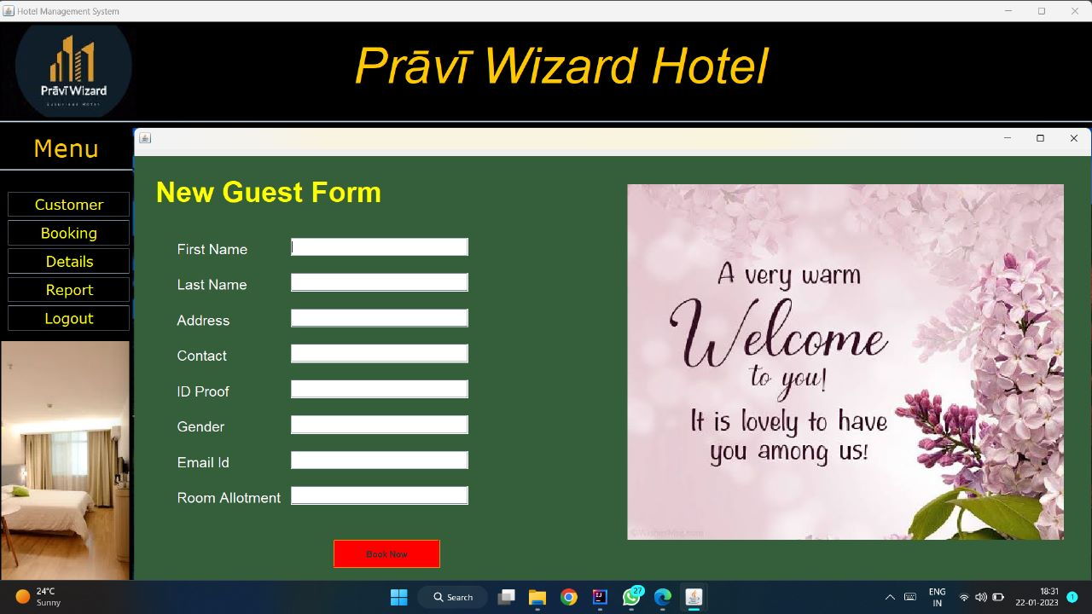
SNAPSHOTS
BOOKING

Slide 12
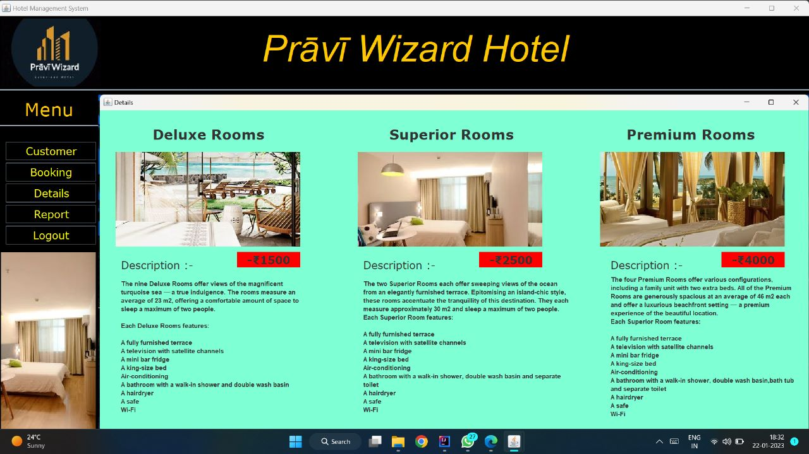
SNAPSHOTS
DETAILS

Slide 13
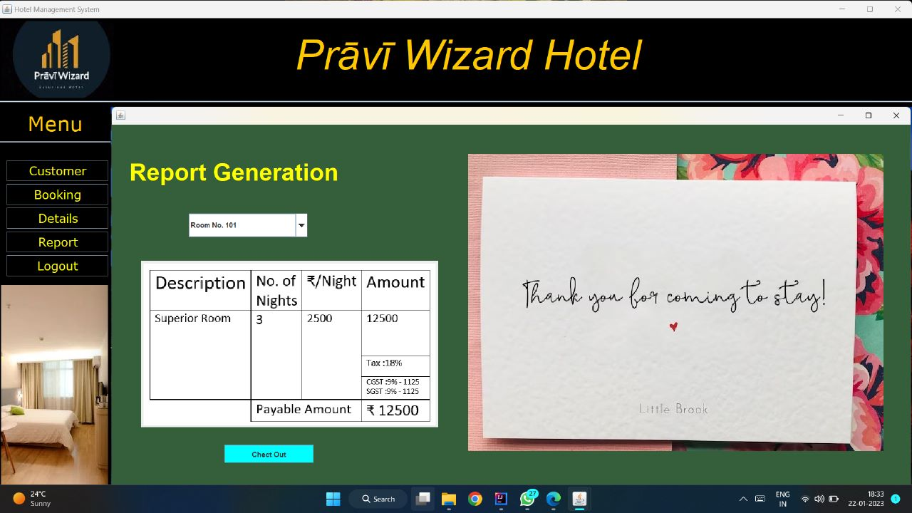
SNAPSHOTS
REPORT

Slide 14
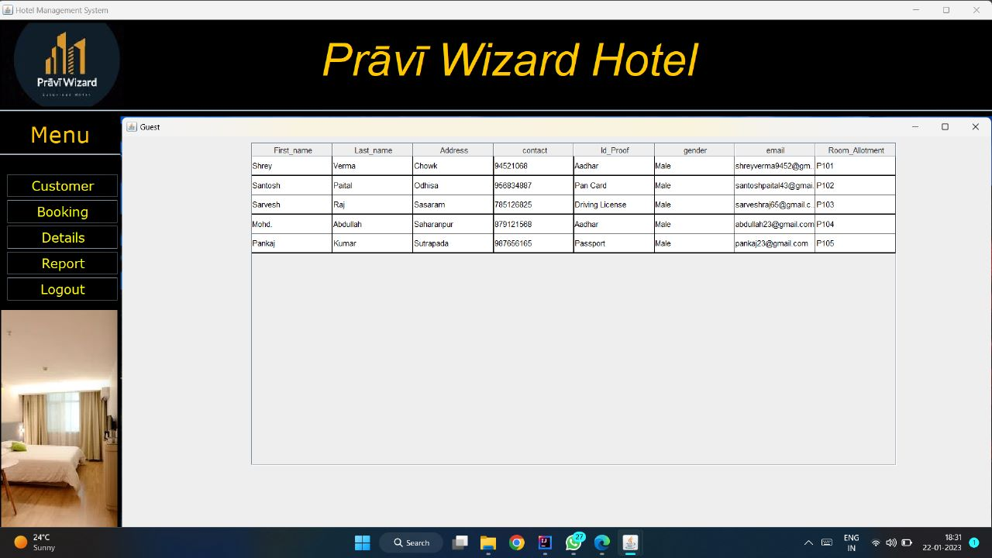
SNAPSHOTS
CUSTOMER

Slide 15
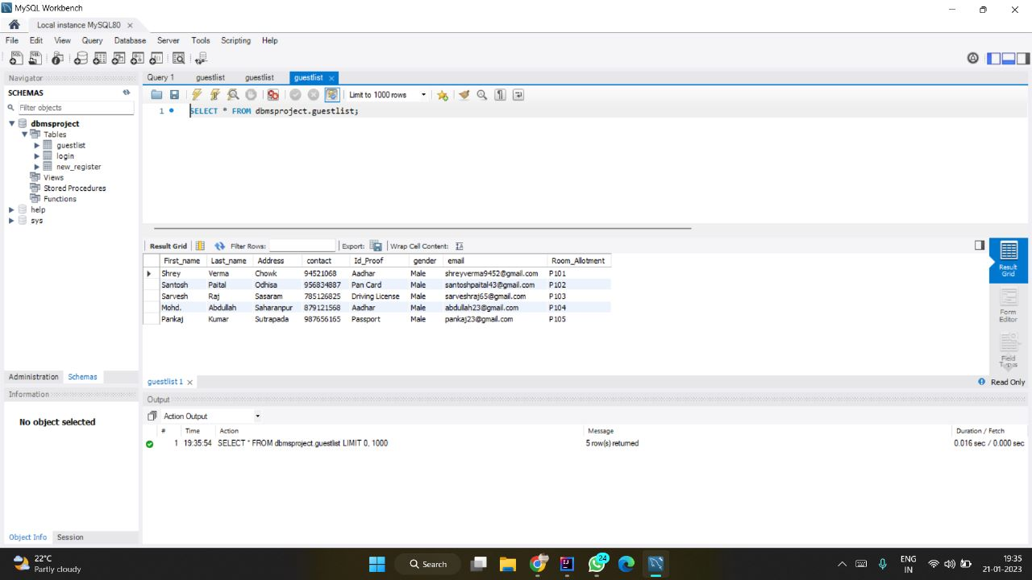
SNAPSHOTS
DATABASES

Slide 16
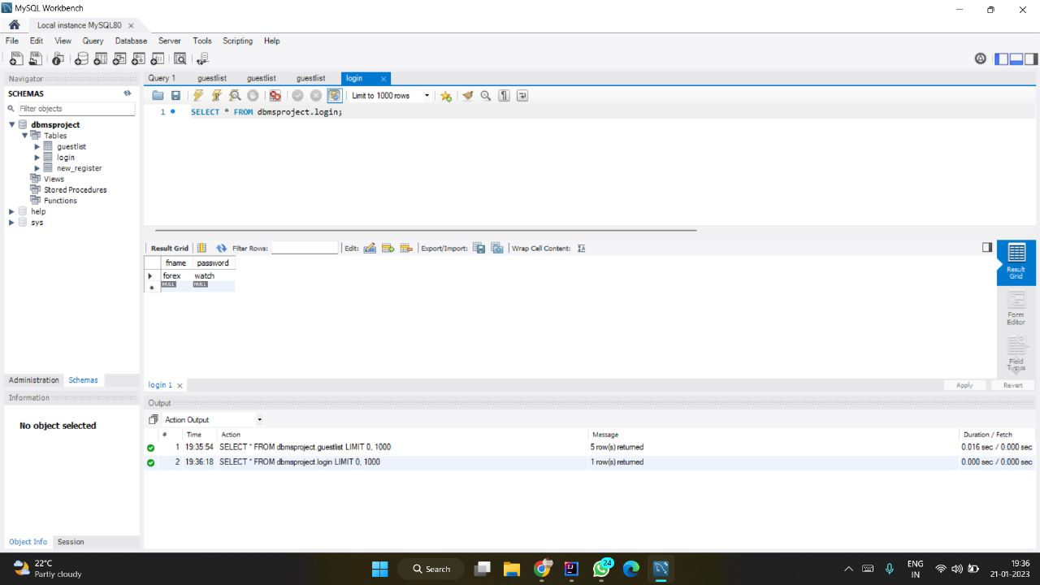
SNAPSHOTS
DATABASES

Slide 17

Thanks
Do you have any questions?
Santosh Kumar Paital (1HK20CS143) 1hk20cs143@hkbk.edu.in
Sarvesh Raj(1HK20CS146) 1hk20cs146@hkbk.edu.in
Shrey Verma(1HK20CS152) 1hk20cs152@hkbk.edu.in

